Slide 1

MAP OF RUSSIA
Federal District | <District>
City name | <City>
City population | <1 000 000>
Distance from Moscow | 1 000 km
1 000 км
Moscow
City

Slide 2
Application for status as an official SOUEAST dealer
— LLC <Name of the company>—
<City>

Slide 3
COMPANY ACTIVITIES
Current auto-brands in portfolio
Start of activity
Showroom area / service
Dealership type (mono-brand/multi-brand)
Sales 2023 pcs
Sales 2024 pcs
Sales 2025 pcs
Number of employees in 2024
Availability of unfinished investments
Photo

Slide 4
COMPANY ACTIVITIES
Current auto-brands in portfolio
Start of activity
Showroom area / service
Dealership type (mono-brand/multi-brand)
Sales 2023 pcs
Sales 2024 pcs
Sales 2025 pcs
Number of employees in 2024
Availability of unfinished investments
Photo

Slide 5
FINANCIAL INDICATORS OF THE COMPANY
INDICATORS |  | Total 2023 | Total 2024 | Total 2025
1. Key performance indicators for car sales | 1.1 Total sales volume (units), including:
1. Основные показатели деятельности по продаже автомобилей | 1.1.1 Sales volume (units), new
 | 1.1.2 Sales volume (units), used/trade-in
 | 1.2 Total sales revenue (million rubles), including:
 | 1.2.1 Sales revenue (million rubles) new
 | 1.2.2 Revenue from sales (million rubles) used/trade-in
 | 1.3 Total sales profit (million rubles):
 | 1.3.1 Profit from sales (million rubles) new
 | 1.3.2 Profit from sales (million rubles) used/trade-in
2. Key performance indicators for repairs | 2.1 Number of car entries (times)
2.Основные показатели деятельности по ремонту | 2.3 Revenue from repair services (RUB million)
 | 2.4 Profit from repair services (million rubles)
3. Key performance indicators for spare parts | 3.1 Revenue from sales of spare parts and accessories (million rubles)
3.Основные показатели деятельности по запчастям | 3.2 Profit from sales of spare parts and accessories (million rubles)
4. Profitability indicators | 4.1 Profit from core activities (million rubles)
4. Показатели прибыли | 4.2 Profit after tax (million rubles)
 | 4.3 Return on sales (%)

Slide 6
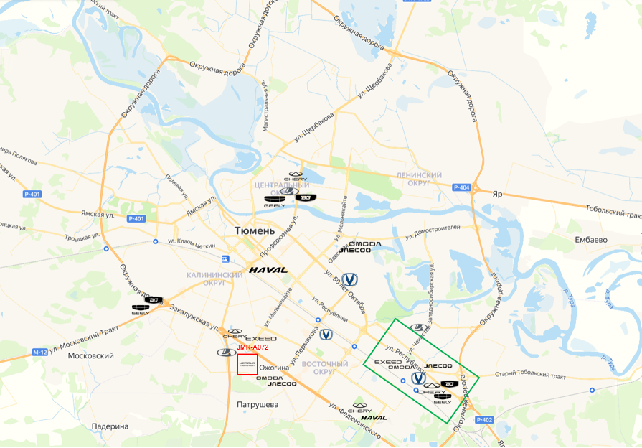
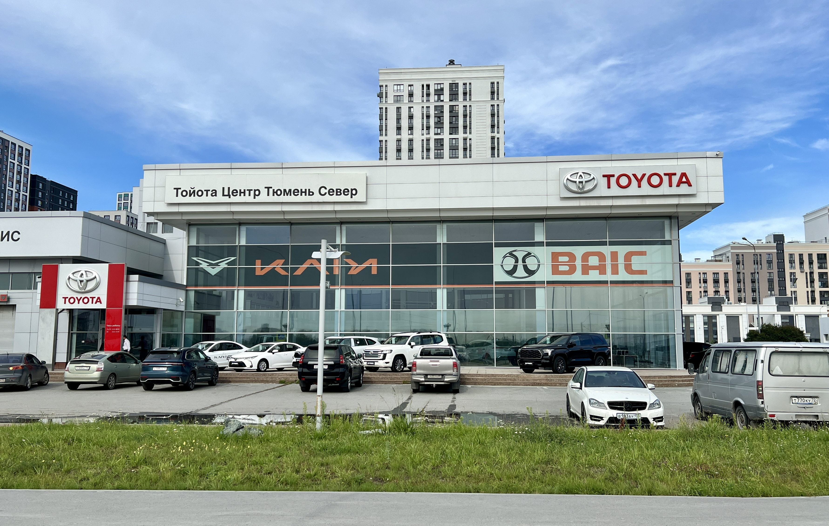
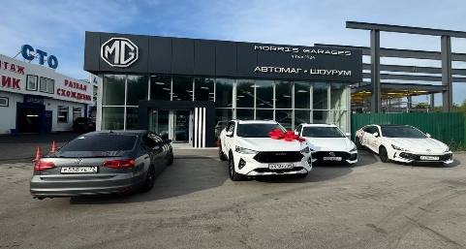
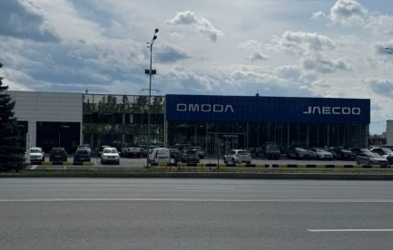
CITY MARKET
FEDERAL DISTRICT | <District>
REGION | <Region>
CITY | <City>
POPULATION | 500 000
DISTANCE FROM THE NEAREST SOUEAST DEALERSHIP | Located in the city (50 km)/ In another city (250 km)
LLC ELIT CAR
LLC AVTOMAG-SURGUT
LLC AUTOGRAD
7.0 км
5.8 км
6.8 км

Slide 7
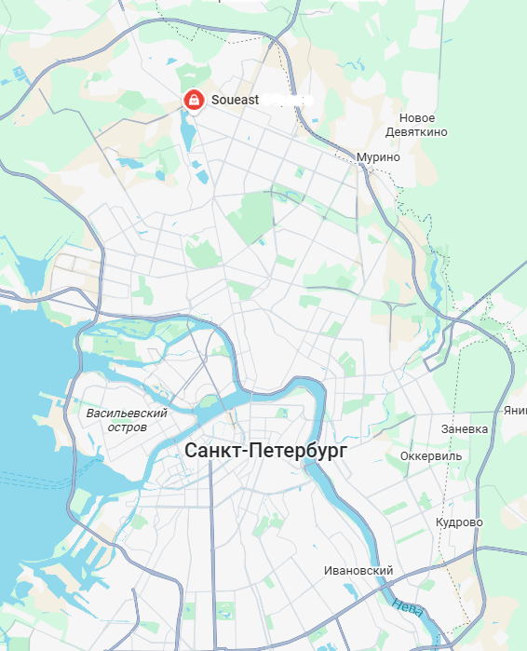
LOCATION OF CURRENT DEALERS

Slide 8
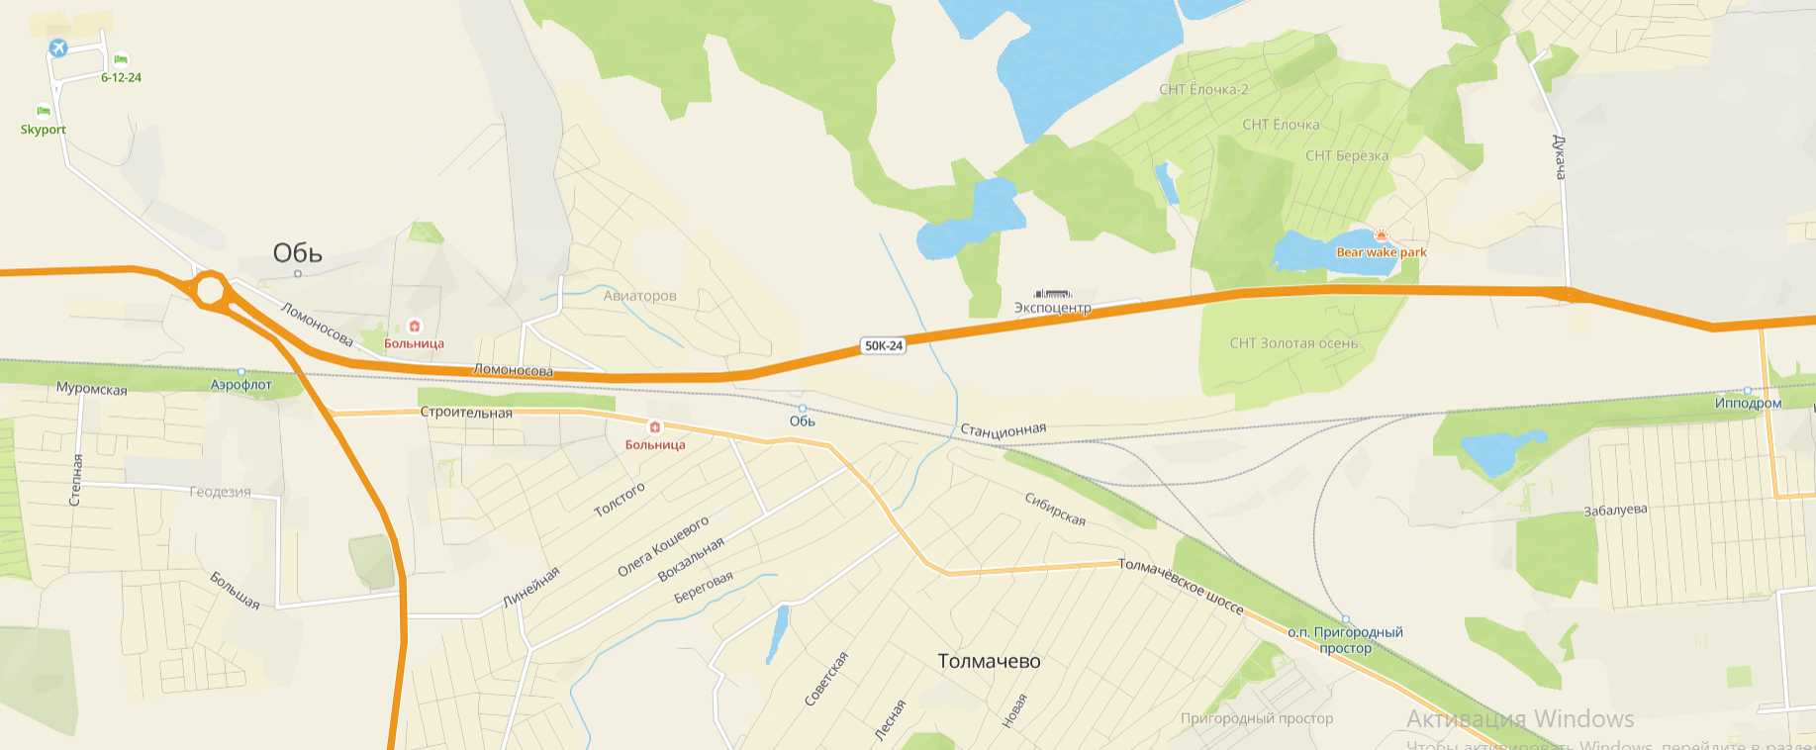
AREA MAP
Аэропорт «Толмачёво»
РусАгроМаркет
Продовольственный парк
Парк
«Экспоцентр»
​Международный выставочный комплекс
Завод Медпрепаратов
Правый берег
Омский тракт
Жилой комплекс
«Радуга Сибири»
Ипподром
Предложение
Жилые кварталы
Жилой комплекс
«Чистая слобода»
<Description of the whereabouts of the dealership center>

Slide 9
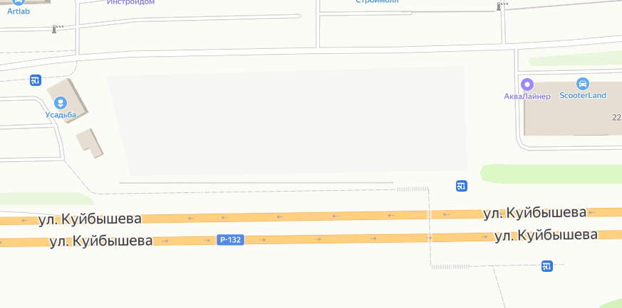
MASTER PLAN
Number of entries into the territory | <number>
Customers parking | <number>
Customers repair zone parking | <number>
New car parking | <number>
3 этаж
Used cars Other brand Other brand
Other brand
Other brand
SOUEAST
1-2 этаж
Автосалон 1
Автосалон 2
Предложение

Slide 10
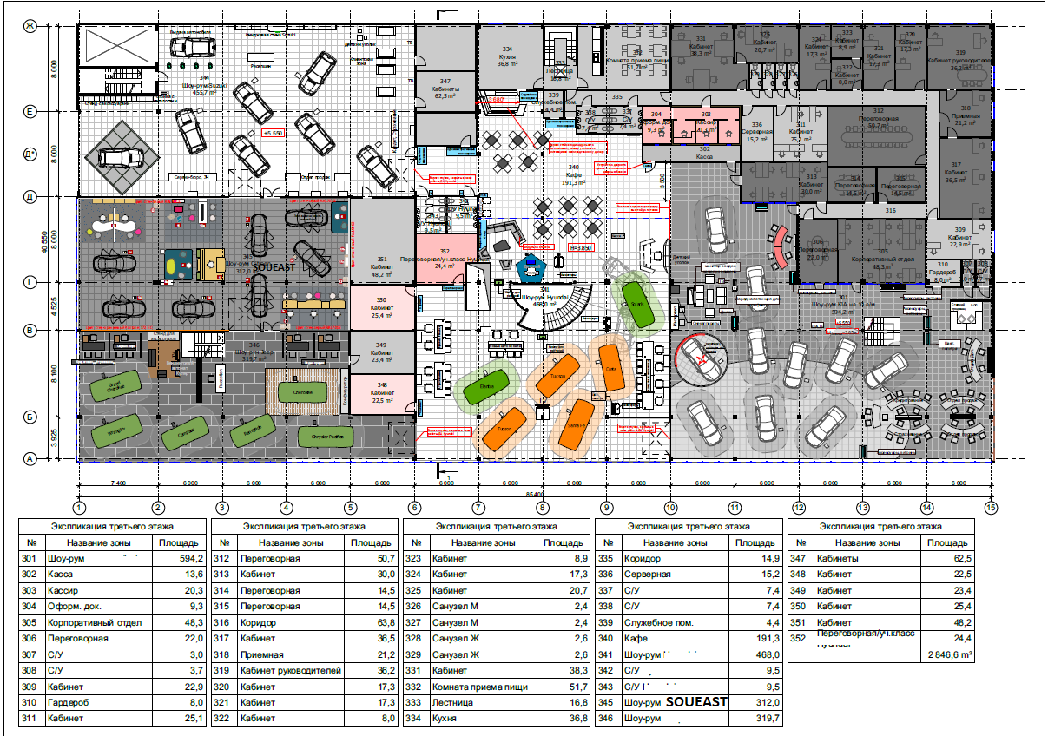
DEALER CENTER LAYOUT
Address | Address
Type of dealership | Multibrand/ monobrand
Ownership status | Own/Rent
Showroom | - 500 m²
Net display area | - 400 m²
Ceiling height | - 5 m
Workshop | - 800 m²
Warehouse | - 100 m²
Other technical rooms | - 70 m²
Body shop | - 1 000 m²
Term of support for architectural brand standards | mm/yyyy
Dealership launch completion date Service owned/outsourced | mm/yyyy Own/outsourced
The presence of encumbrances, restrictions (building footprint, facade and signage), bank collateral, etc. | No/Yes

Slide 11
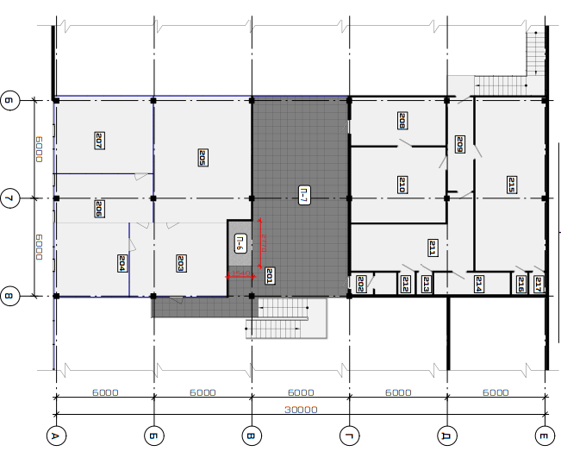
DEALER CENTER LAYOUT
Other rooms | 15

Slide 12
LOCATION
Фото здания
сделать под прямым углом
Фото прилегающей территории
слева
Фото прилегающей территории
справа
Фото входной группы
сделать под прямым углом
Фото парковки тестового парка
сделать под прямым углом
Фото клиентской парковки
сделать под прямым углом

Slide 13
LOCATION
Фото шоу-рума
сделать под прямым углом
Фото шоу-рума
с первого этажа
Фото ресепшена
со второго этажа
Фото сервиса
сделать под прямым углом
Фото сервиса
с первого этажа
Фото подъемников
со второго этажа

Slide 14
BUSINESS PLAN
PERIOD | 2025 | 2026 | 2027 | 2028
TOTAL
MODEL
MODEL
MODEL
MODEL
MODEL

Slide 15
LAUNCH PLAN
CITY | LAUNCH PLAN | DATE
Address | Placement of temporary banner
 | Formation of the staffing schedule
 | Project development
 | Buying cars from the test fleet
 | Purchase of a minimum package of spare parts and accessories.
 | Coordination of the project with Distribution
 | Payment for SOUEAST corporate identification elements
 | Installation of external and internal elements of corporate identification
 | Passing the audit
 | Beginning of active work

